Slide 1
MCA Final Year Project (Review II)
E-SAHAKARA (Initialization and configuration, General Ledger & Financial Statements)
Submitted to the Presidency University, Bengaluru in partial fulfillment for the award of the degree of Master of Computer Applications(MCA)
Project Number : MCA_PR218
Ass
Under the supervision of
Mr. S. Shakthi
Asst. Prof of SCSE
Presidency University, Bengaluru
Name | Roll Number
Shubhan G C | 20232MCA0194

Slide 2
Content
Problem Statement
Screenshot
Github link

Slide 3
Problem Statement
Lack of Standardized Setup - Cooperative societies struggle with inconsistent system configurations, leading to operational inefficiencies and compliance issues.
Data Validation Issues – The absence of automated validation mechanisms results in inaccurate member and financial records, impacting decision-making
Inaccurate Financial Tracking – Manual bookkeeping leads to errors in transaction records, affecting financial integrity and decision-making.
Audit and Reporting Challenges – The absence of structured audit trails makes financial verification and reporting cumbersome, increasing the risk of discrepancies.

Slide 4

Screenshots
Login Page

Slide 5
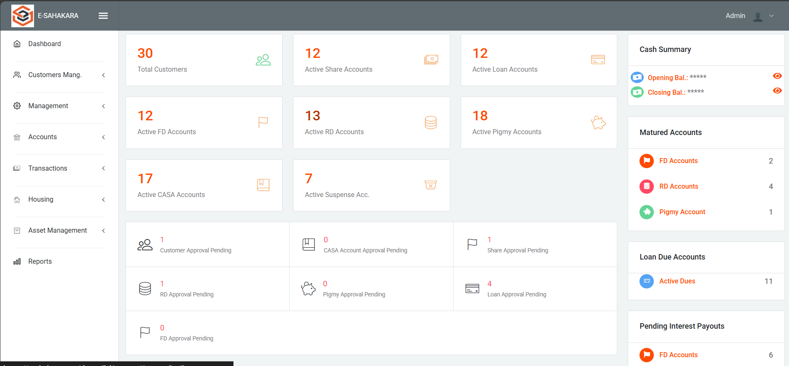
Dashboard

Slide 6
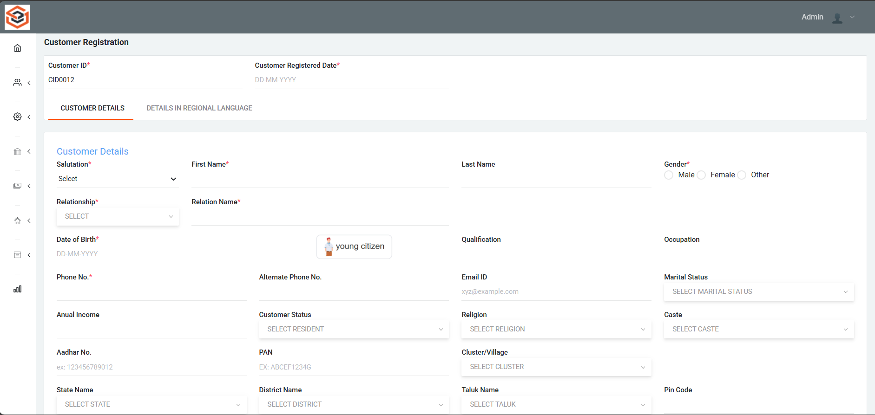
Customer registration page

Slide 7
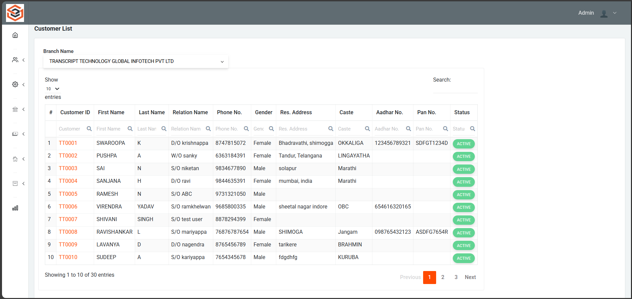
Customer list page

Slide 8
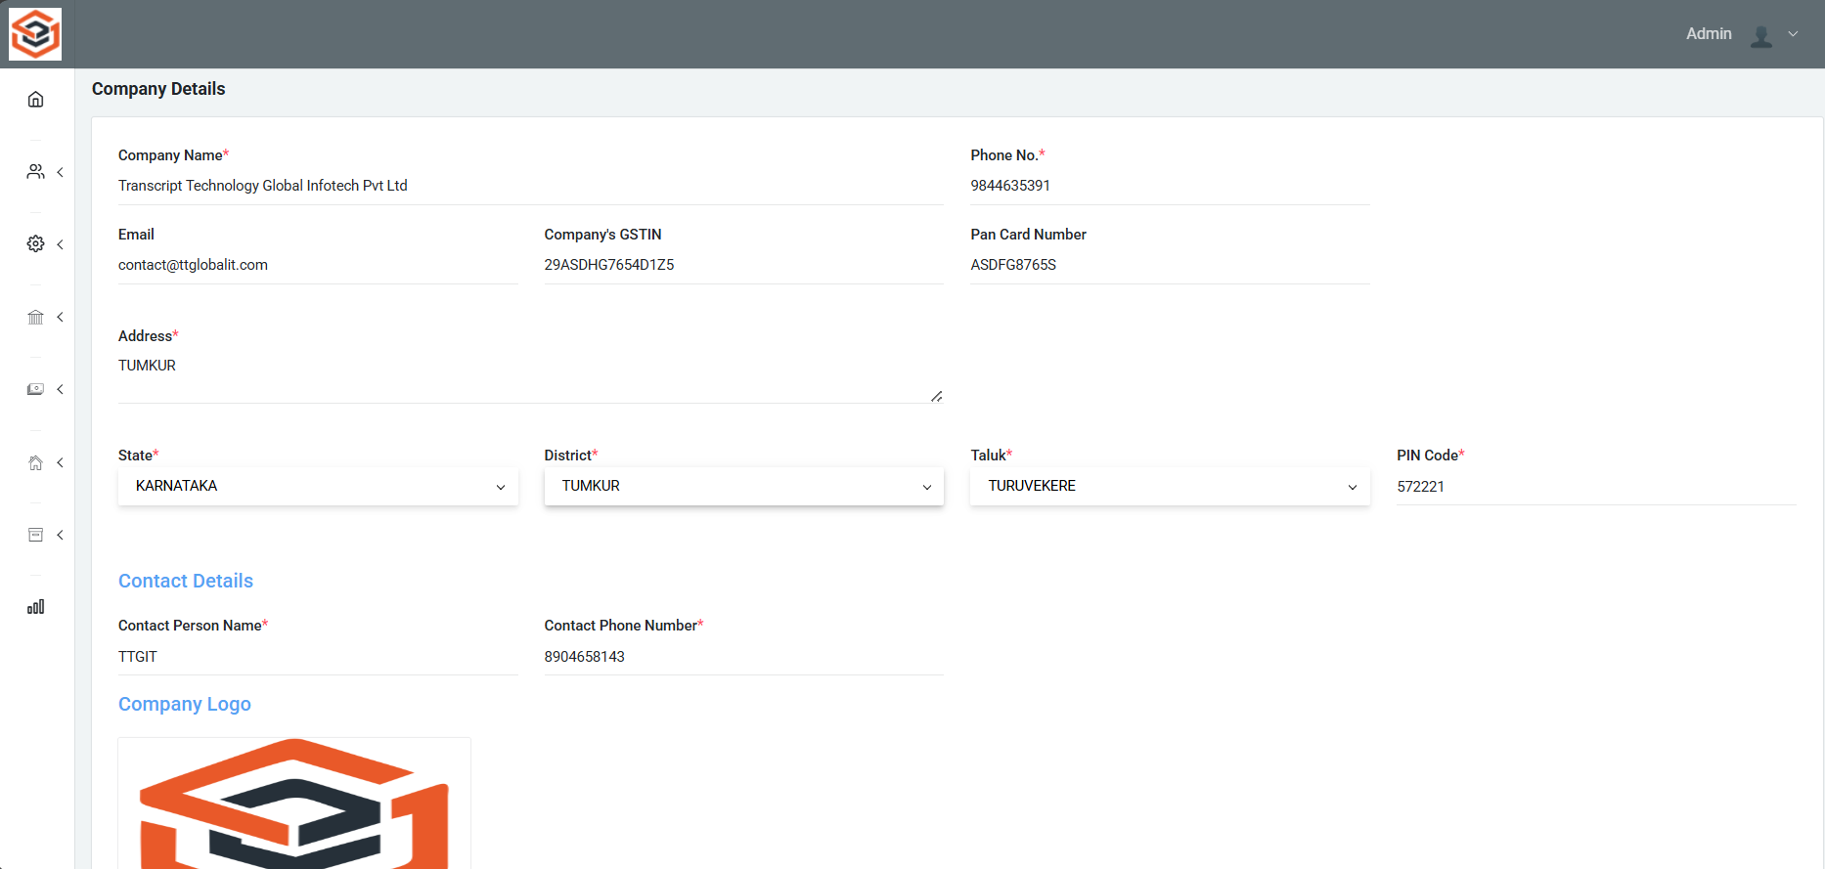
Company Details

Slide 9
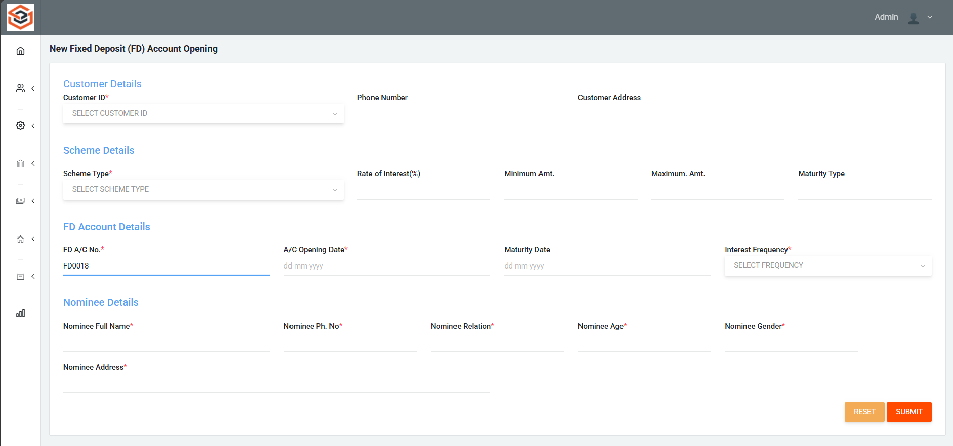
FD Account opening page

Slide 10
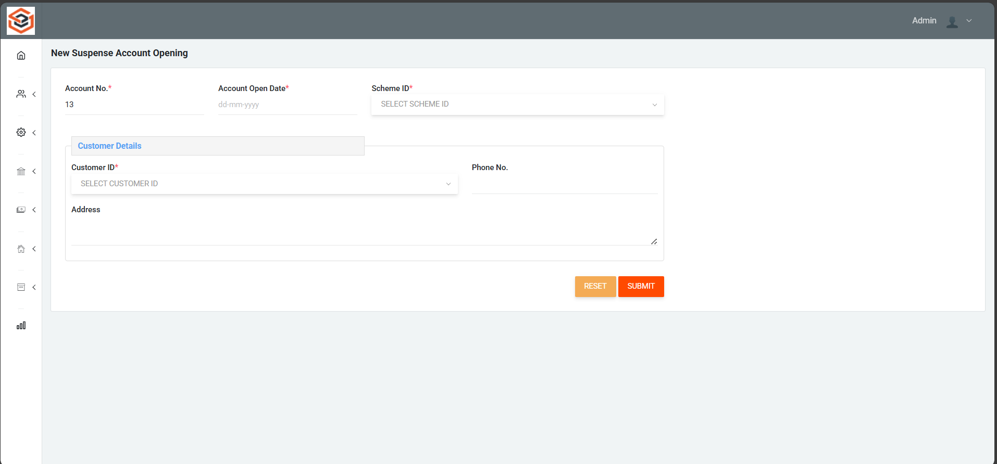
Suspense Account opening page

Slide 11
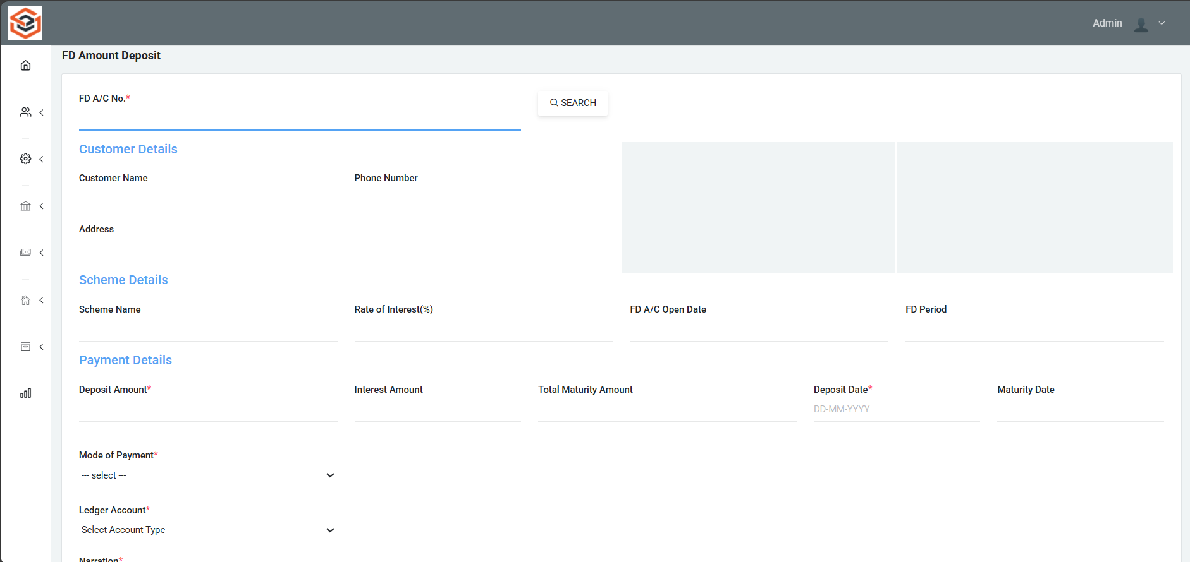
FD Amount Deposit

Slide 12
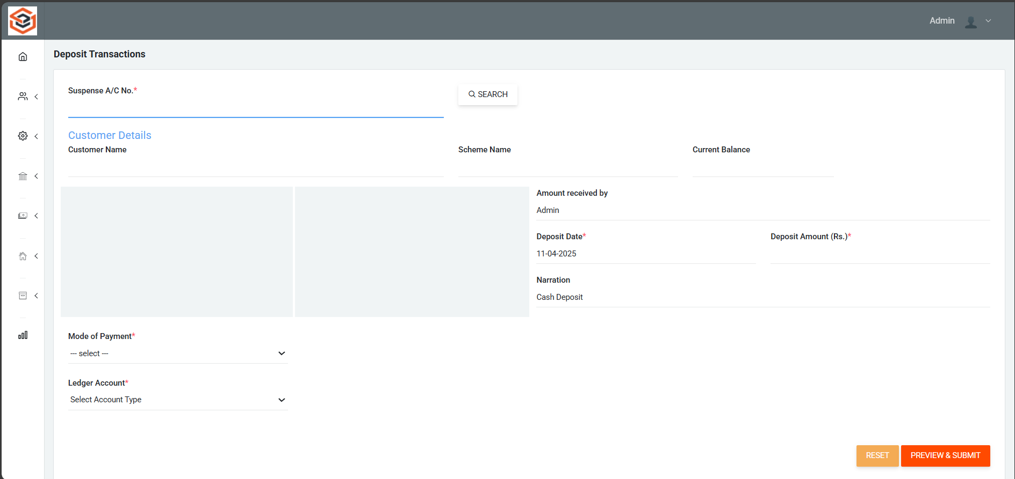
FD Deposit Transactions page

Slide 13
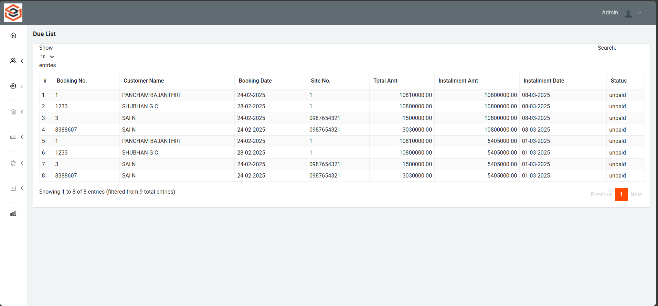
Loan Due List page

Slide 14
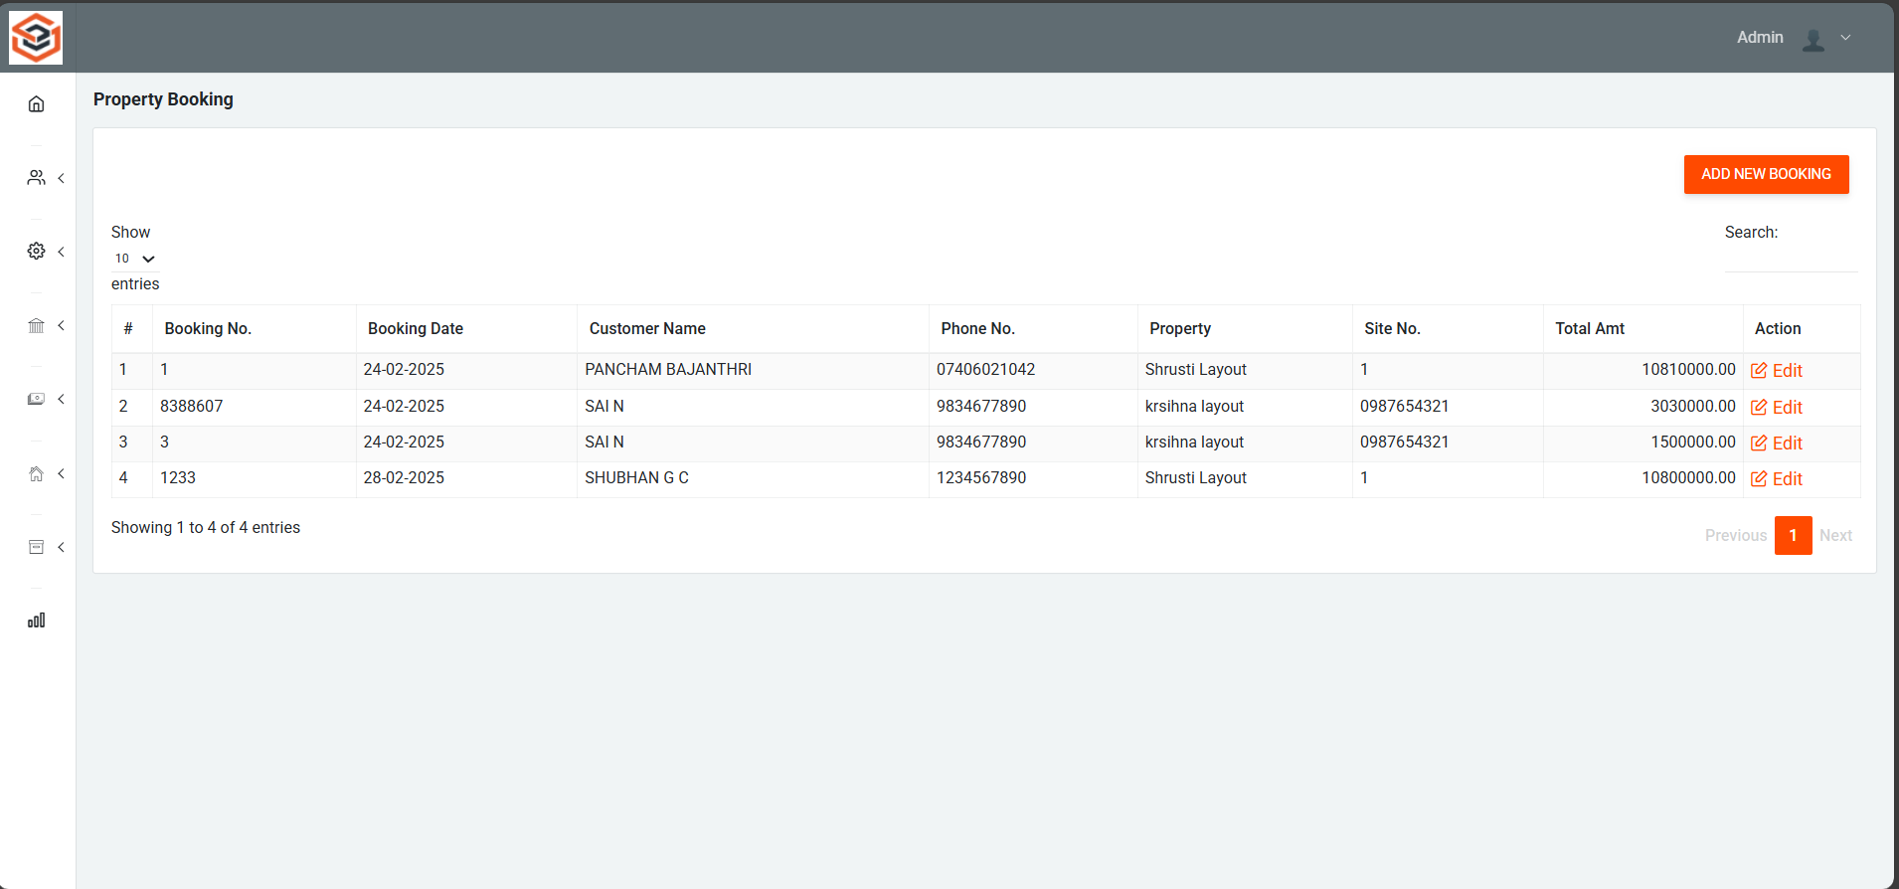
Property Booking Page

Slide 15
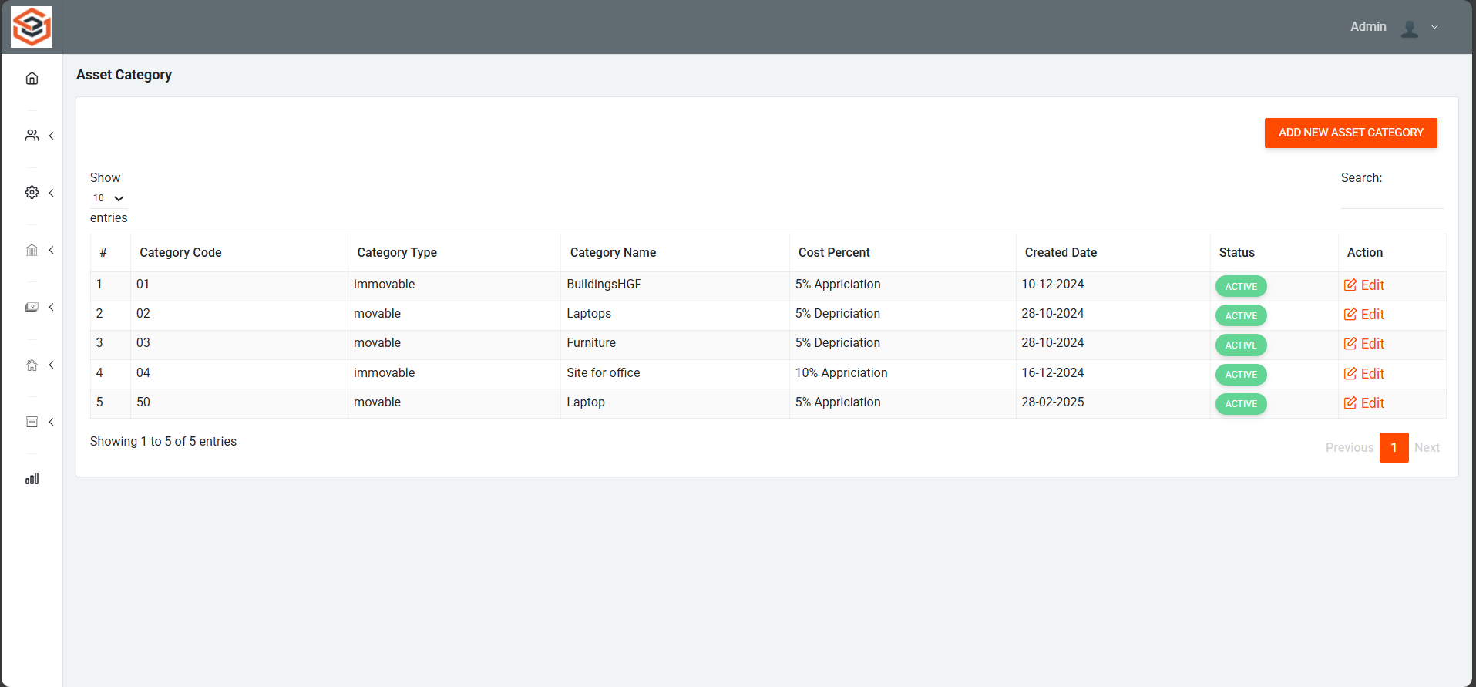
Asset Category List

Slide 16
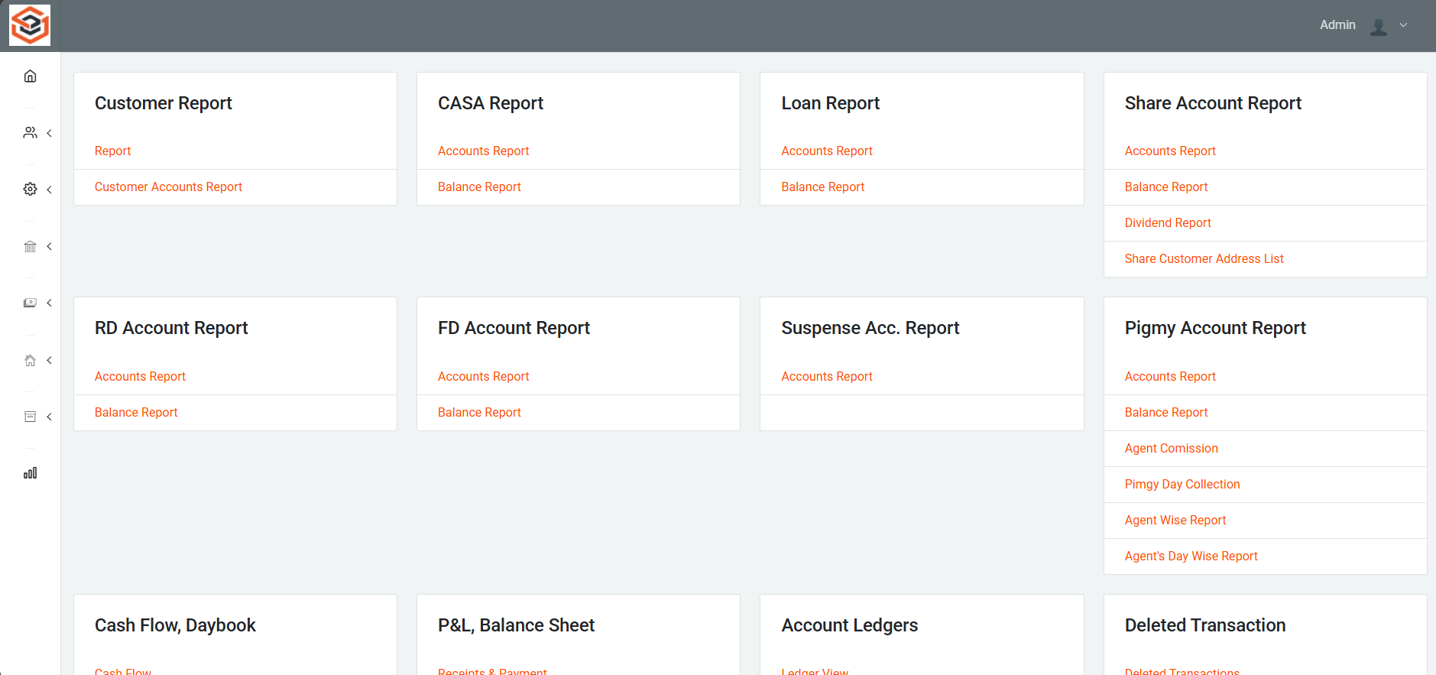
Reports Page

Slide 17


